Slide 1
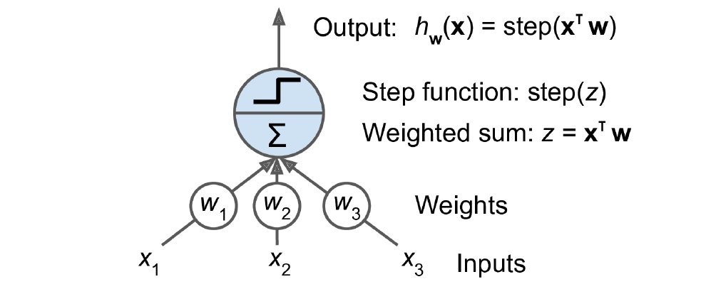
Perceptron
(y)
y
Threshold logic unit: an artificial neuron which computes a weighted sum of its inputs then applies a step function

Slide 2
Perceptron
Perceptron is one of the simplest ANN architectures, invented in 1957 by Frank Rosenblatt.
It is based on a slightly different artificial neuron called a threshold logic unit (TLU), or sometimes a linear threshold unit (LTU).
The inputs and output are numbers, and each input connection is associated with a weight.
The TLU computes a weighted sum of its inputs
Y = w₁ x₁+ w₂ x₂ + ⋯ + w_{n}x_{n} = x⊺w
Then applies a step function to that sum and outputs the result:
h_{w}(x) = step(y), where Y = x⊺w.

Slide 3
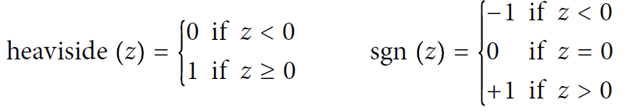
Perceptron
Common step functions used in Perceptron (assuming threshold =0)
A single TLU can be used for simple linear binary classification. It computes a linear combination of the inputs, and if the result exceeds a threshold, it outputs the positive class. Otherwise, it outputs the negative class (just like a Logistic Regression or linear SVM classifier)
For example, use a single TLU to classify iris flowers based on petal length and width (also adding an extra bias feature x0 = 1)
Training a TLU in this case means finding the right values for w0, w1, and w2

Slide 4
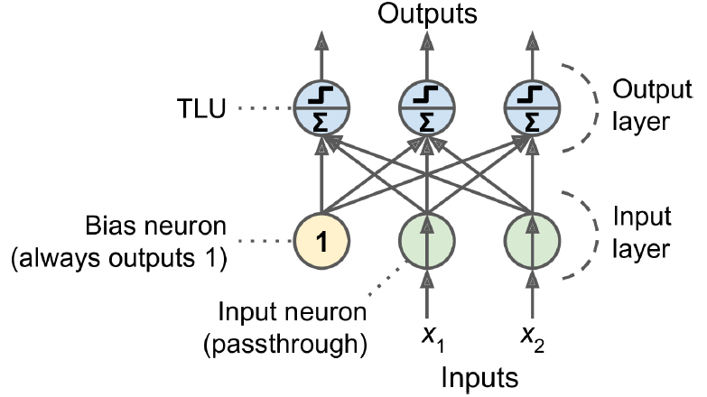
Perceptron
Architecture of a Perceptron with two input neurons, one bias neuron, and three output neurons

Slide 5
Perceptron
A Perceptron is simply composed of a single layer of TLUs,with each TLU connected to all the inputs.
When all the neurons in a layer are connected to every neuron in the previous layer (i.e., its input neurons), the layer is called a fully connected layer, or a dense layer.
The inputs of the Perceptron are fed to special passthrough neurons called input neurons: they output whatever input they are fed. All the input neurons form the input layer.
An extra bias feature is generally added (x0 = 1): it is typically represented using a special type of neuron called a bias neuron, which outputs 1 all the time.
This Perceptron can classify instances simultaneously into three different binary classes, which makes it a multioutput classifier.

Slide 6
Perceptron
Computing the outputs of a fully connected layer
h_{W, b}(X) = ϕ(XW + b)
X represents the matrix of input features. It has one row per instance and one column per feature.
The weight matrix W contains all the connection weights except for the ones from the bias neuron. It has one row per input neuron and one column per artificial neuron in the layer.
The bias vector b contains all the connection weights between the bias neuron and the artificial neurons. It has one bias term per artificial neuron.
The function ϕ is called the activation function: when the artificial neurons are TLUs, it is a step function.

Slide 7
Perceptron
A Perceptron is a type of artificial neuron, introduced by Frank Rosenblatt in 1958.
A perceptron takes several inputs, applies weights to them, adds a bias, and then passes the result through an activation function to produce an output.
A Perceptron is the most fundamental unit of an artificial neural network, which is widely used in machine learning and artificial intelligence.
It is inspired by the functioning of a biological neuron and is used to perform binary classification—that is, to decide whether something belongs to one class or another (e.g., yes/no, true/false, safe/unsafe).

Slide 8
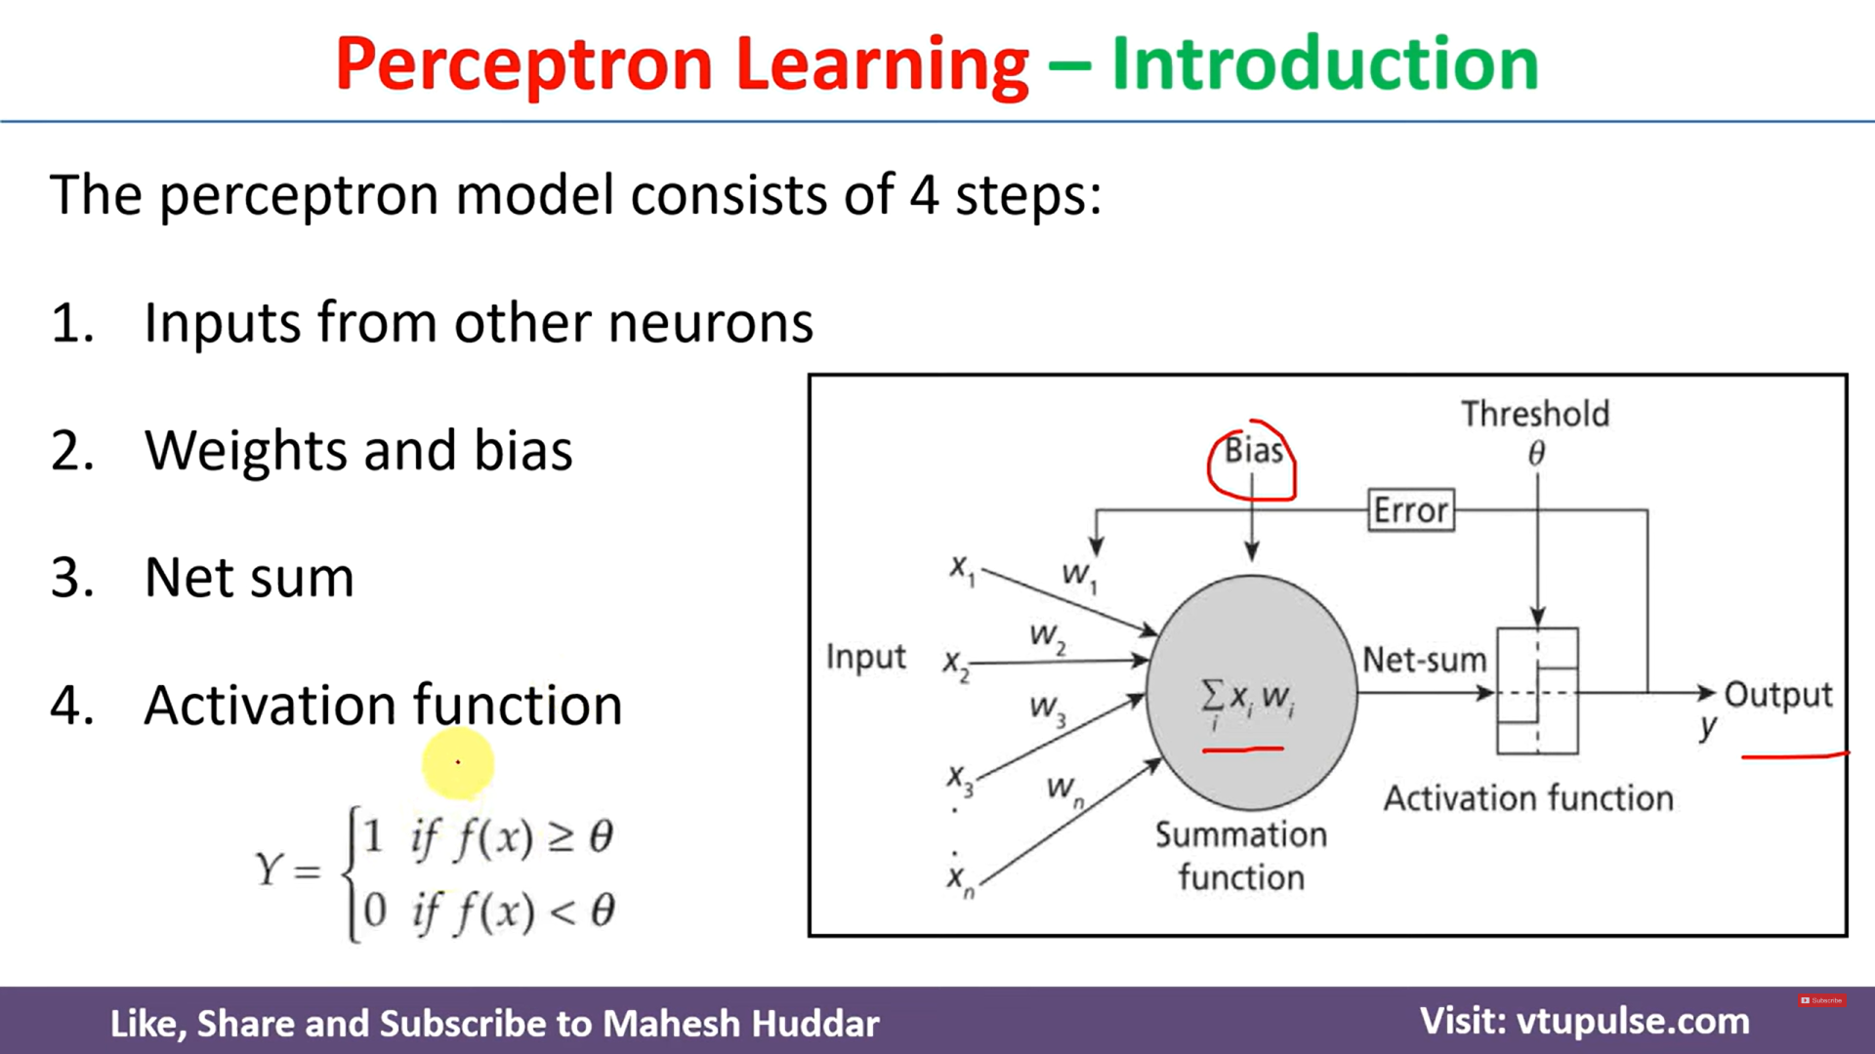

Slide 9
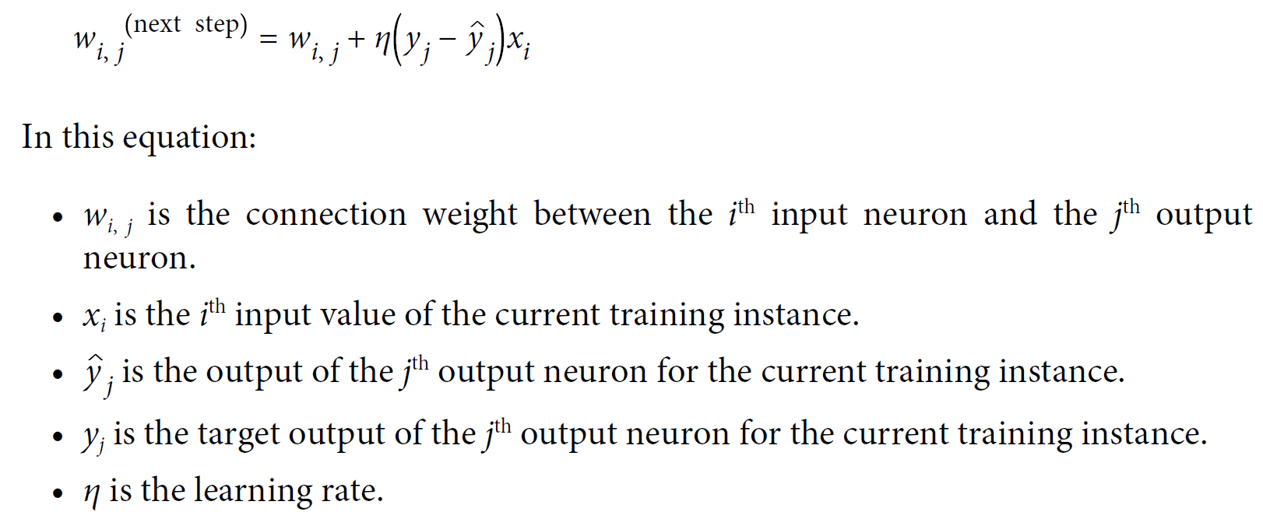
Perceptron learning rule (weight update)

Slide 10
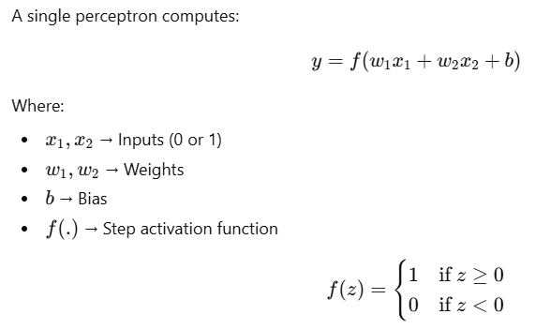
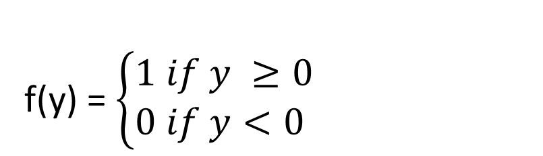
Single Perceptron
f(y) = $\left\{\begin{aligned}1 if y ≥0 \\ 0 if y<0 \end{aligned}\right.$

Slide 11
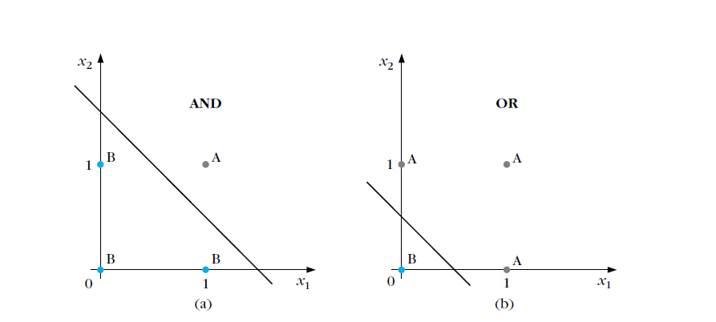
Example for one layer Perceptron
Can Solve Only Linearly Separable Problems

Slide 12

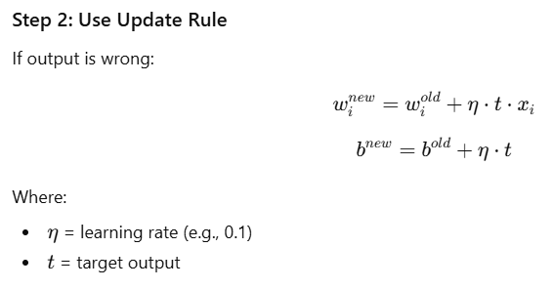
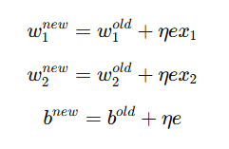


Perceptron Learning Algorithm (Training Method) – AND GATE
Truth Table
x₁ | x₂ | O/P | Class
0 | 0 | 0 | B
0 | 1 | 0 | B
1 | 0 | 0 | B
1 | 1 | 1 | A

Slide 13
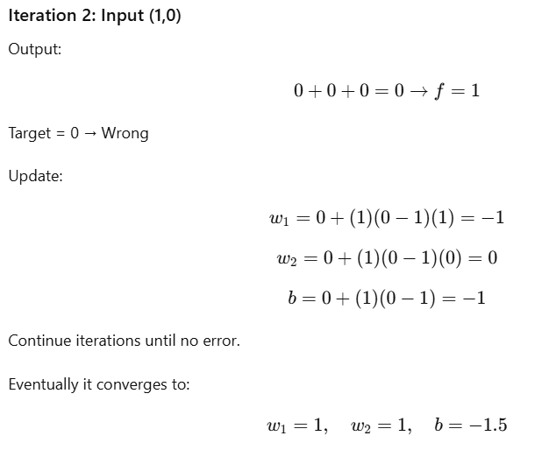
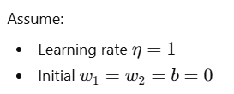
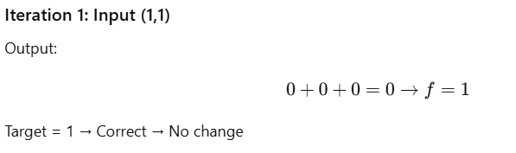
Perceptron Learning Algorithm (Training Method) – AND GATE

Slide 14
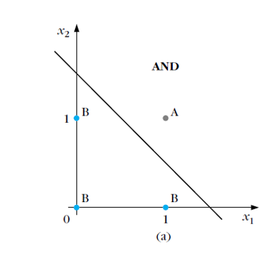
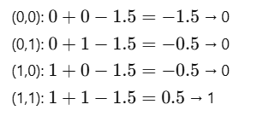
Perceptron Learning Algorithm (Training Method) – AND GATE
Verify for the input

Slide 15
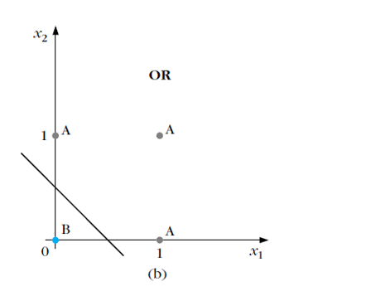
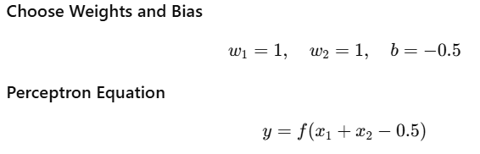
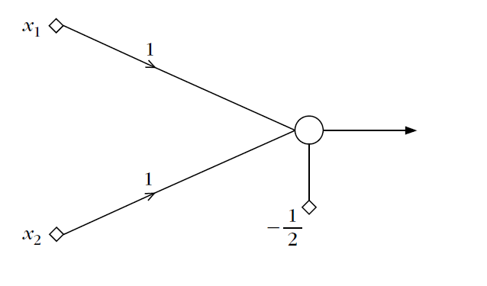
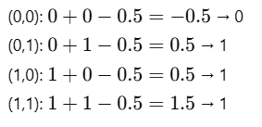
OR Gate Using Single Perceptron
Truth Table
x₁ | x₂ | O/P | Class
0 | 0 | 0 | B
0 | 1 | 1 | A
1 | 0 | 1 | A
1 | 1 | 1 | A

Slide 16
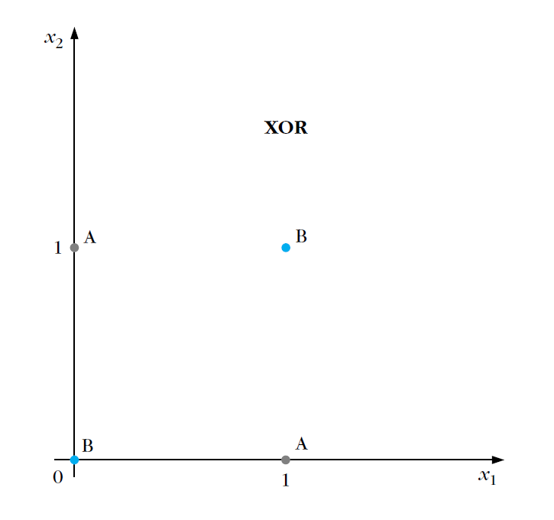
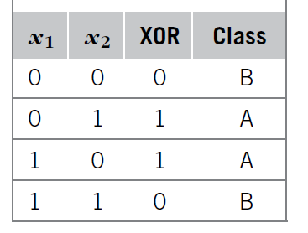
Limitations of one layer Perceptron
It cannot solve non-linearly separable problems.
Example (XOR Problem – Does NOT Work)

Slide 17
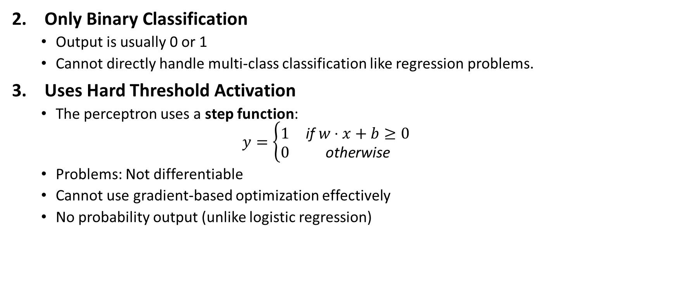
Limitations of one layer Perceptron
Only Binary Classification
Output is usually 0 or 1
Cannot directly handle multi-class classification like regression problems.
Uses Hard Threshold Activation
The perceptron uses a step function:
$$y=\left\{\begin{matrix}1 & \text{if} w⋅x+b≥0 \\ 0 & \text{otherwise}\end{matrix}\right.$$
Problems: Not differentiable
Cannot use gradient-based optimization effectively
No probability output (unlike logistic regression)

Slide 18
Limitations of one layer Perceptron
No Hidden Layer (Limited Learning Capacity)
No nonlinear activation in between/ It cannot learn complex patterns or feature interactions.
Sensitive to Learning Rate and Initialization
If data is not linearly separable → training may never converge.
If learning rate is too high → unstable updates.
If too low → very slow convergence.
No Feature Learning
It cannot automatically extract new features.
Works only with manually engineered input features.
Cannot Model Complex Decision Boundaries
Real-world problems often require curved boundaries, multiple regions and hierarchical feature learning
Single-layer perceptron cannot handle these.

Slide 19
Limitations of one layer Perceptron were overcome by
Multi-Layer Perceptron (MLP)
Hidden layers
Non-linear activation functions (ReLU, Sigmoid, Tanh)
Backpropagation algorithm

Slide 20
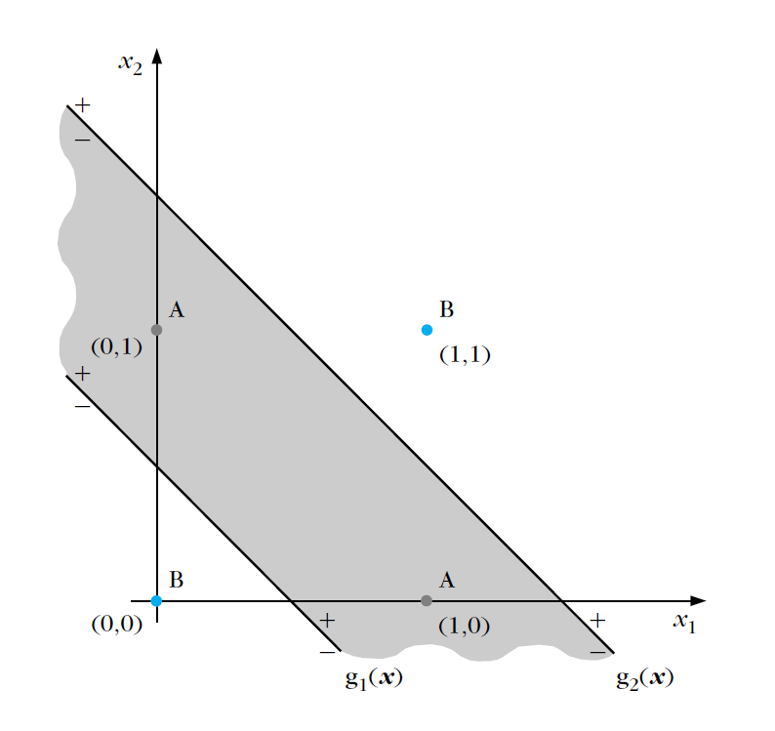
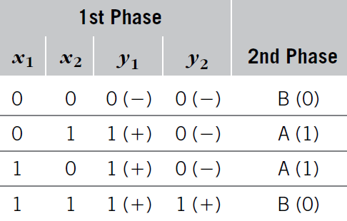
XOR problem - TWO-LAYER PERCEPTRON

Slide 21
XOR problem - TWO-LAYER PERCEPTRON
Two phase of decision
Perform a mapping of the input vector x to a new one y [ y1, y2]^{T}.
Transformed data
[ y1, y2][0, 0] and [ y1, y2][1, 1], which correspond to class B vectors,
[ y1, y2][1, 0], which correspondsto class A vectors.
Mapping of the first phase transforms the nonlinearly separable problem to a linearly separable one.

Slide 22
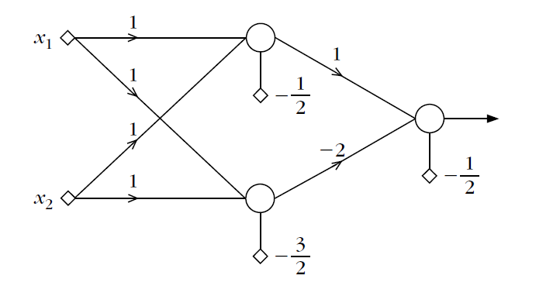
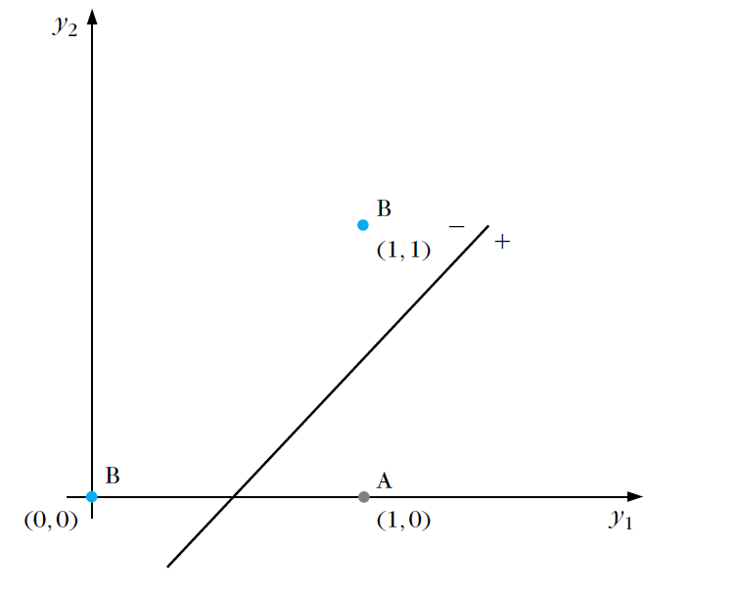
XOR problem - TWO-LAYER PERCEPTRON
Two-layer perceptron two-layer feedforward neural network

Slide 23
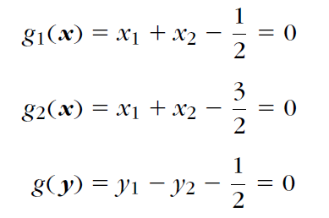
XOR problem - TWO-LAYER PERCEPTRON
The two neurons (nodes) of the first layer perform computations of the first phase and they constitute the so-called hidden layer.
The single neuron of the second layer performs the computations of the final phase and constitutes the output layer.
Input layer corresponds to the (nonprocessing) nodes where input data are applied. Thus, the number of input layer nodes equals the dimension of the input space.
The lines that are realized by the two-layer perceptron

Slide 24
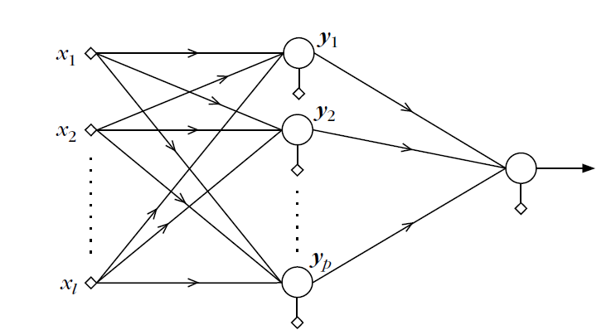
A two-layer perceptron

Slide 25
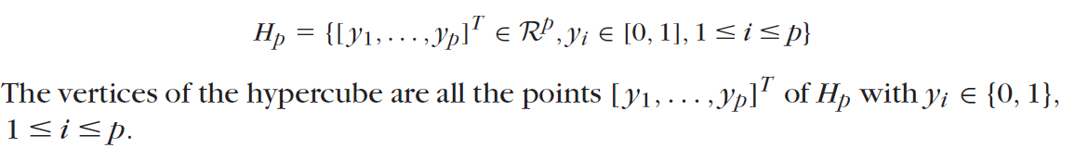
A two-layer perceptron
Input vectors in the l-dimensional space, that is, x ∈ R^{l} , and p neurons in the hidden layer
Hypercube of unit side length in the p-dimensional space, denoted by Hp.
The mapping of the input space onto the vertices of the hypercube is achieved via the creation of p hyperplanes. Each of the hyperplanes is created by a neuron in the hidden layer, and the output of each neuron is 0 or 1, depending on the relevant position of the input vector with respect to the corresponding hyperplane.

Slide 26
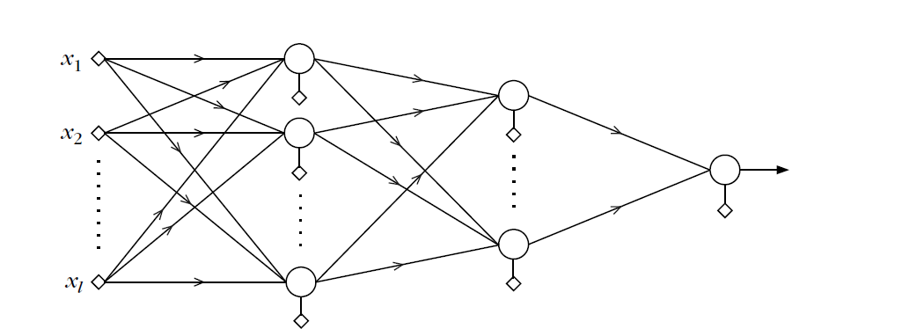
THREE-LAYER PERCEPTRONS
The inability of the two-layer perceptron to separate classes resulting from any union of polyhedral regions springs from the fact that the output neuron can realize only a single hyperplane. The difficulty was overcome by constructing two lines instead of one.

Slide 27
THREE-LAYER PERCEPTRONS
Three-layer perceptron architecture with two layers of hidden neurons and one output layer.
P neurons of the first hidden layer, which perform the mapping of the input space onto the vertices of the Hp hypercube of unit side length
Class A consists of the union of K of the resulting polyhedra and class B of the rest
Use K neurons in the second hidden layer. Each of these neurons realizes a hyperplane in the p-dimensional space. The synaptic weights for each of the second-layer neurons are chosen so that the realized hyperplane leaves only one of the Hp vertices on one side and all the rest on the other.
For each neuron a different vertex is isolated, that is, one of the K A class vertices
Each time an input vector from class A enters the network, one of the K neurons of the second layer results in a 1 and the remaining K -1 give 0
For class B vectors all neurons in the second layer output a 0.
Choose the output layer neuron to realize an OR gate. Its output will be 1 for class A and 0 for class B vectors.

